Slide 1
Category review: Chips
June 2020
Retail Analytics
Brand note: If client logo is not required, use alternate title page layout right click slide thumbnail > Layout > Title

Slide 2
Notes:
To view Privacy video explaining how important data privacy is to Quantium, please click here: https://www.youtube.com/watch?v=Zq1QDAkoRzU
or here Q:\Company Reference\Brand & Design\Brand videos\Q Privacy.mp4
At Quantium, we believe that data is the behavioural footprint of humanity and that it has to be treated with the utmost care and responsibility.
Histories, attitudes, indeed lives are stored within it in ways that aren’t always apparent – and that’s what makes its potential so powerful.
To work with it responsibly, sensitively, we set ourselves the highest data privacy protection and governance standards.
We have spent 17 years perfecting privacy-by-design and secure-by-design principles. Central to this is not holding any personally identifiable information about people –
we neither receive it, and put the necessary protections in place to be unable to decipher it.
Every aspect of handling data is safeguarded: from its de-identification, to its encryption – data security is paramount and of the highest grade.
We pride ourselves on gaining the trust of iconic organisations around the world through years of securely working with their data,
and in turn the trust that builds with their stakeholders.

Slide 3
Executive summary
The day with no transaction/sales was on 25th december,2018 which was a Christmas day so all stores were closed.
Top 3 sales contributor segment of chips are: Older families (Budget), Young Singles/Couples & Retires (Mainstream).
Young Singles/Couples (Mainstream) and Retirees (Mainstream) have higher population than Older Families(Budget) which explains there high total sales.
4. Midage singles/couples(Mainstream) and young singles/couples(Mainstream) are paying more per packets then other 2 premium customer Budgets and Premium.
>Mainstream customers have higher average price per unit than other non-mainstream customers like Budget and premium customers
>young singles/couples(Mainstream ) are more likely to purchase Tyrrells chips compared to other brands.
5. Mainstream customers are mostly likely to purchase 270gm of "Twisties" brand chips.
01
Task 1
02
1. Trial store 77: Control store 233 2. Trial store 86: Control store 155 3. Trial store 88: Control store 40 4. Both trial store 77 and 86 showed significant increase in Total Sales and Number of Customers during trial period. But not for trial store 88. Perhaps the client knows if there's anything about trial 88 that differs it from the other two trial. 5. Overall the trial showed positive significant result.
Task 2

Slide 4
01
Category
Conduct analysis on your client's transaction dataset and identify customer purchasing behaviors to generate insights and provide commercial recommendations.
Main goals of these tasks are:
1. Examine transaction data - check for missing data, anomalies, outliers and clean them 2. Examine customer data - similar to above transaction data 3. Data analysis and customer segments - create charts and graphs, note trends and insights 4. Deep dive into customer segments - determine which segments should be targeted

Slide 5
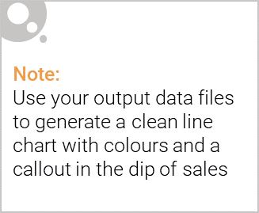
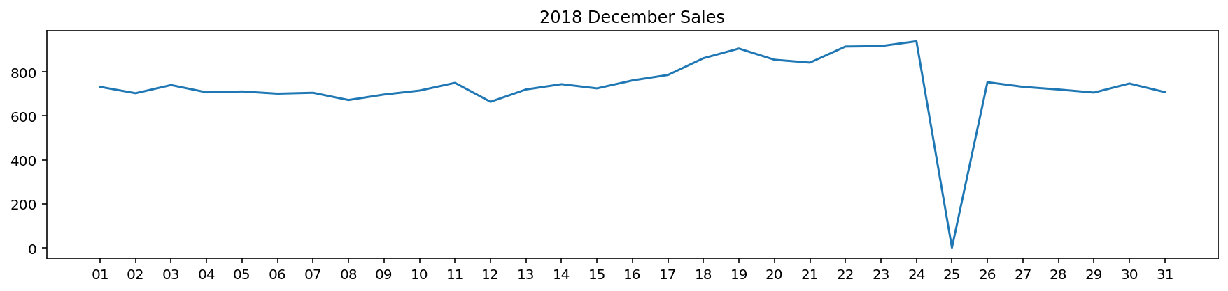
Overview: your key callout for the category should be included here
The day with no transaction is a Christmas day that is when the store is closed hence there is a dip in sales on 25th December as shops were non- operational.
Sales increase steadily as the Christmas day approaches and return again
to early December sales level during New Year Eve.

Slide 6
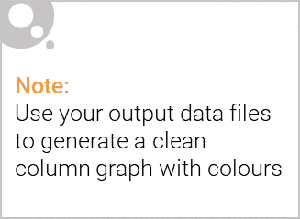
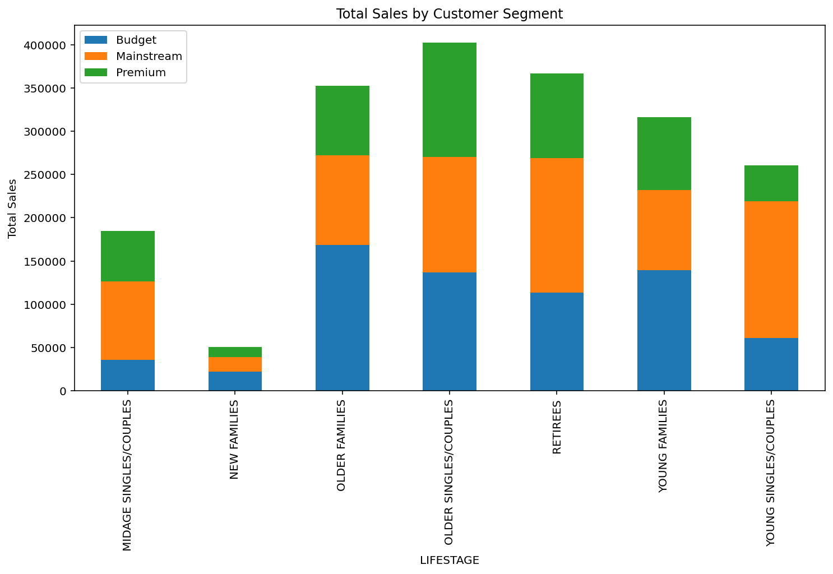
This slide will be commentary on affluence and its effect on consumer buying for the category of chips
The top 3 total sales contributor segment are (in order): 1.Older Families(Budget) 2.Young Singles/Couples
(Mainstream) 3.Retirees (Mainstream)

Slide 7
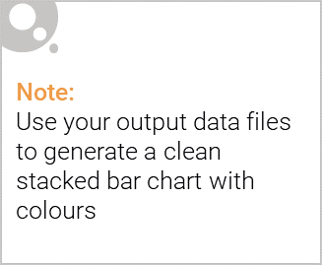
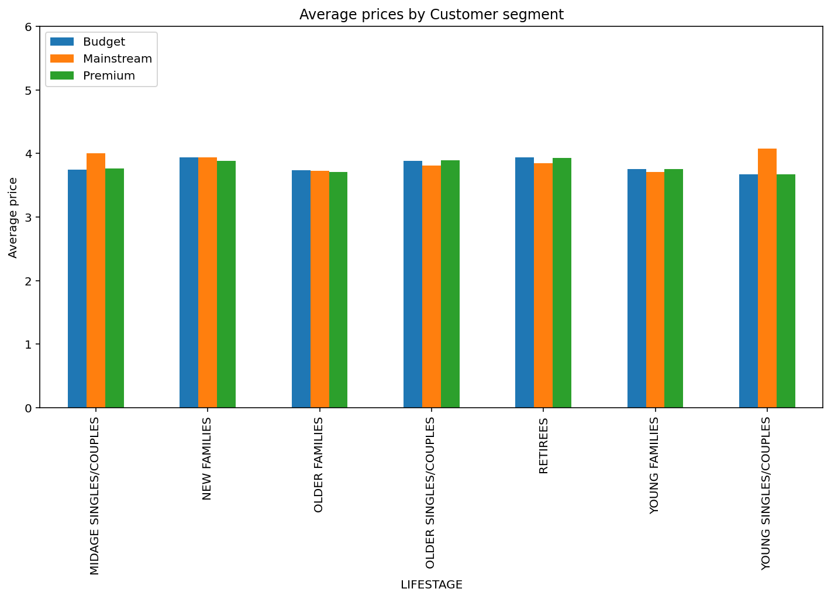
Editable (delete this)
Stretch: Try visualising the proportion of customers by affluence and life stage on this slide
Midage singles/couples(Mainstream) and young singles/couples(Mainstream) are paying more per packets then other 2 premium customer Budgets & Premium. This may be due to premium shoppers being more likely to buy healthy snacks and where chips are mostly used for entertainment purpose.

Slide 8
02
Trial store performance
Julia has asked us to evaluate the performance of a store trial which was performed in stores 77, 86 and 88.
This can be broken down by: 1. Total Sales Revenue 2. Total Number of Customers 3. Average Number of Transactions per Customer
Main areas of focus are:
1. Select control stores – Explore data, define metrics, visualize graphs 2. Assessment of the trial – insights/trends by comparing trial stores with control stores 3. Collate findings – summarize and provide recommendations

Slide 9
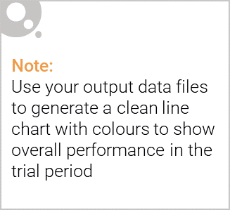
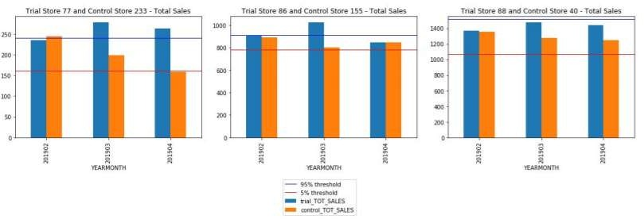
Explanation of the control store vs other stores
We can see that Trial store 77 sales for Feb, March, and April exceeds 95% threshold of control store. Same goes to store 86 sales for all 3 trial months.
Whereas trial store 88 sales increase is insignificant.

Slide 10
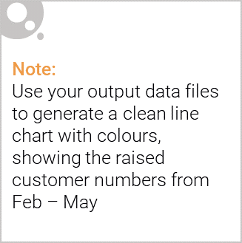
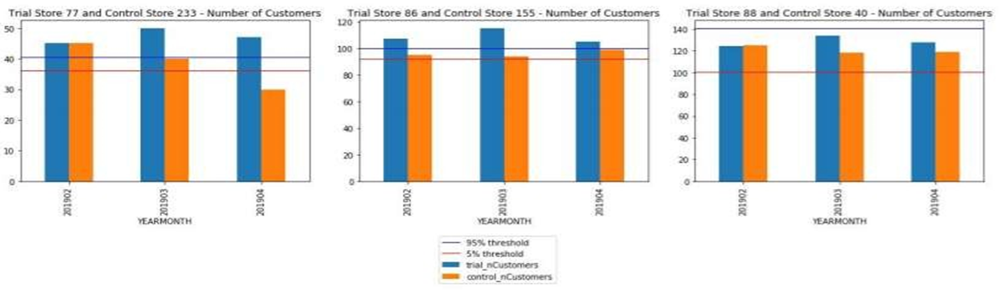
Call out of the performance in the trial store, determining if it was successful
1.Trial store 77: Control store 233
2.Trial store 86: Control store 155
3.Trial store 88: Control store 40
4.Both trial store 77 and 86 showed significant increase in Total Sales and Number of Customers during trial period. But not for trial store 88. Perhaps the client knows if there's anything about trial 88 that differs it from the other two trial.
5.Overall the trial showed positive significant result.

